Slide 1
Data Mining:
Concepts and Techniques
(3rd ed.)
— Chapter 10 —
Jiawei Han, Micheline Kamber, and Jian Pei
University of Illinois at Urbana-Champaign &
Simon Fraser University
©2011 Han, Kamber & Pei. All rights reserved.

Slide 2
Chapter 10. Cluster Analysis: Basic Concepts and Methods
Cluster Analysis: Basic Concepts
Partitioning Methods
Hierarchical Methods
Density-Based Methods
Grid-Based Methods
Evaluation of Clustering
Summary

Slide 3
Hierarchical Clustering
Use distance matrix as clustering criteria. This method does not require the number of clusters k as an input, but needs a termination condition
Step 0
Step 1
Step 2
Step 3
Step 4
agglomerative
(AGNES- Agglomerative Nesting)
a
a b
b
a b c d e
c
c d e
d
d e
e
divisive
(DIANA- Divisive Analysis)
Step 4
Step 3
Step 2
Step 1
Step 0

Slide 4

AGNES (Agglomerative Nesting)
Introduced in Kaufmann and Rousseeuw (1990)
Implemented in statistical packages, e.g., Splus
Use the single-link method and the dissimilarity matrix
Merge nodes that have the least dissimilarity
Go on in a non-descending fashion
Eventually all nodes belong to the same cluster

Slide 5
Dendrogram: Shows How Clusters are Merged
  Decompose data objects into a several levels of nested partitioning (tree of clusters), called a dendrogram
  A clustering of the data objects is obtained by cutting the dendrogram at the desired level, then each connected component forms a cluster

Slide 6
DIANA (Divisive Analysis)
Introduced in Kaufmann and Rousseeuw (1990)
Implemented in statistical analysis packages, e.g., Splus
Inverse order of AGNES
Eventually each node forms a cluster on its own

Slide 7
Distance between Clusters
X
X
Single link: smallest distance between an element in one cluster and an element in the other, i.e., dist(K_{i}, K_{j}) = min(t_{ip}, t_{jq})
Complete link: largest distance between an element in one cluster and an element in the other, i.e., dist(K_{i}, K_{j}) = max(t_{ip}, t_{jq})
Average: avg distance between an element in one cluster and an element in the other, i.e., dist(K_{i}, K_{j}) = avg(t_{ip}, t_{jq})
Centroid: distance between the centroids of two clusters, i.e., dist(K_{i}, K_{j}) = dist(C_{i}, C_{j})
Medoid: distance between the medoids of two clusters, i.e., dist(K_{i}, K_{j}) = dist(M_{i}, M_{j})
  Medoid: a chosen, centrally located object in the cluster

Slide 8



Centroid, Radius and Diameter of a Cluster (for numerical data sets)
Centroid: the “middle” of a cluster
Radius: square root of average distance from any point of the cluster to its centroid
Diameter: square root of average mean squared distance between all pairs of points in the cluster

Slide 9
Extensions to Hierarchical Clustering
Major weakness of agglomerative clustering methods
  Can never undo what was done previously
  Do not scale well: time complexity of at least O(n²), where n is the number of total objects
Integration of hierarchical & distance-based clustering
  BIRCH (1996): uses CF-tree and incrementally adjusts the quality of sub-clusters
  CHAMELEON (1999): hierarchical clustering using dynamic modeling

Slide 10
Probabilistic Hierarchical Clustering
Algorithmic hierarchical clustering
  Nontrivial to choose a good distance measure
  Hard to handle missing attribute values
  Optimization goal not clear: heuristic, local search
Probabilistic hierarchical clustering
  Use probabilistic models to measure distances between clusters
  Generative model: Regard the set of data objects to be clustered as a sample of the underlying data generation mechanism to be analyzed
  Easy to understand, same efficiency as algorithmic agglomerative clustering method, can handle partially observed data
In practice, assume the generative models adopt common distributions functions, e.g., Gaussian distribution or Bernoulli distribution, governed by parameters

Slide 11
Chapter 10. Cluster Analysis: Basic Concepts and Methods
Cluster Analysis: Basic Concepts
Partitioning Methods
Hierarchical Methods
Density-Based Methods
Grid-Based Methods
Evaluation of Clustering
Summary

Slide 12
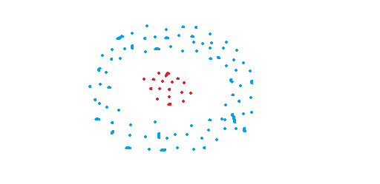
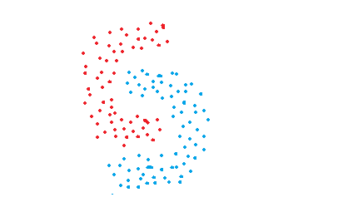
DBSCAN algorithm
The data points in these figures are grouped in arbitrary shapes or include outliers. Density-based clustering algorithms are very effienct at finding high-density regions and outliers. It is very important to detect outliers for some task, e.g. anomaly detection.

Slide 13
Density-Based Clustering Methods
Clustering based on density (local cluster criterion), such as density-connected points
Major features:
  Discover clusters of arbitrary shape
  Handle noise
  One scan
  Need density parameters as termination condition
Several interesting studies:
  DBSCAN: Ester, et al. (KDD’96) Density-Based Spatial Clustering of Applications with Noise
  OPTICS: Ankerst, et al (SIGMOD’99).
  DENCLUE: Hinneburg & D. Keim (KDD’98)
  CLIQUE: Agrawal, et al. (SIGMOD’98) (more grid-based)

Slide 14
Density-Based Clustering: Basic Concepts
Two parameters:
  Eps: Maximum radius of the neighbourhood
  MinPts: Minimum number of points in an Eps-neighbourhood of that point
N_{Eps}(p): {q belongs to D | dist(p,q) ≤ Eps}
Directly density-reachable: A point p is directly density-reachable from a point q w.r.t. Eps, MinPts if
  p belongs to N_{Eps}(q)
  core point condition:
  |N_{Eps} (q)| ≥ MinPts
p
MinPts = 5
Eps = 1 cm
q

Slide 15
Density-Reachable and Density-Connected
Density-reachable:
  A point p is density-reachable from a point q w.r.t. Eps, MinPts if there is a chain of points p₁, …, p_{n}, p₁ = q, p_{n} = p such that p_{i+1} is directly density-reachable from p_{i}
Density-connected
  A point p is density-connected to a point q w.r.t. Eps, MinPts if there is a point o such that both, p and q are density-reachable from o w.r.t. Eps and MinPts
p
p₁
q
p
q
o

Slide 16
DBSCAN: Density-Based Spatial Clustering of Applications with Noise
Relies on a density-based notion of cluster: A cluster is defined as a maximal set of density-connected points
Discovers clusters of arbitrary shape in spatial databases with noise
Outlier
Border
Eps = 1cm
MinPts = 5
Core

Slide 17
DBSCAN: The Algorithm
Arbitrary select a point p
Retrieve all points density-reachable from p w.r.t. Eps and MinPts
If p is a core point, a cluster is formed
If p is a border point, no points are density-reachable from p and DBSCAN visits the next point of the database
Continue the process until all of the points have been processed

Slide 18



DBSCAN: Sensitive to Parameters

Slide 19
A cluster includes core points that are neighbors (i.e. reachable from one another) and all the border points of these core points. The required condition to form a cluster is to have at least one core point. Although very unlikely, we may have a cluster with only one core point and its border points.

Slide 20

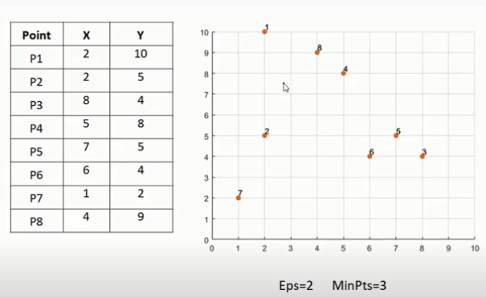

Slide 21
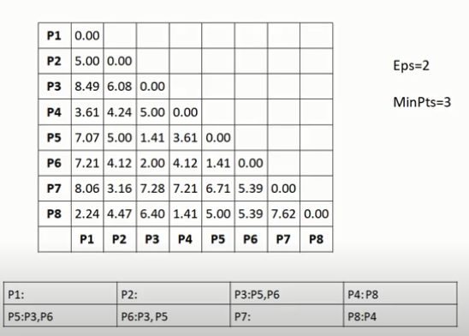

Slide 22
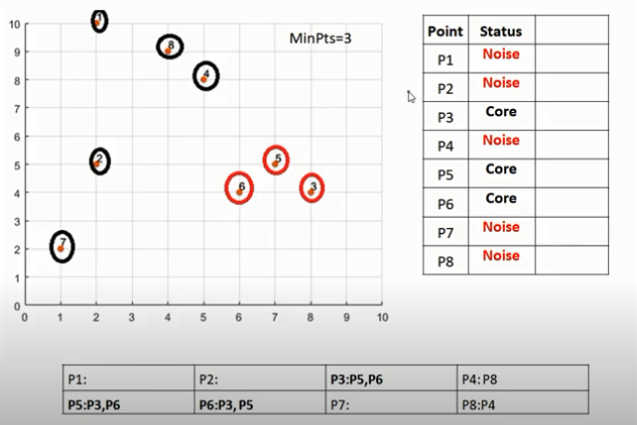
Cluster formed : cluster 1 with points (3,5 and 6 ) other points are noise

Slide 23
Points 3,5 and 6 form a cluster

Slide 24
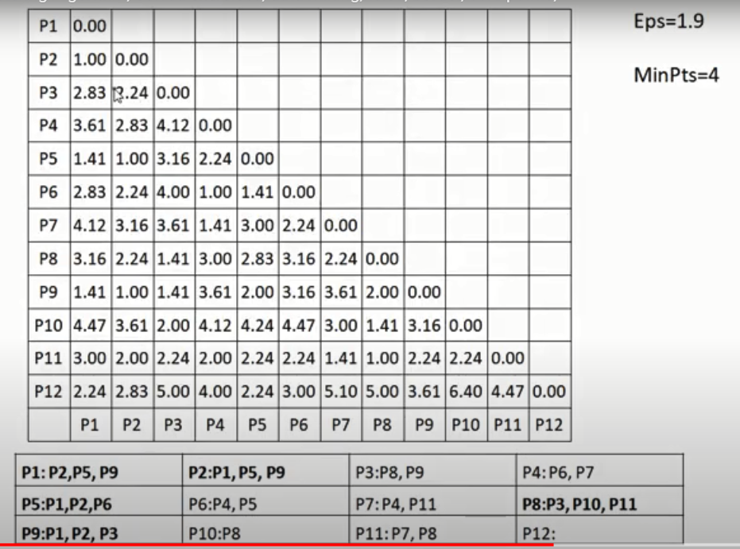

Slide 25
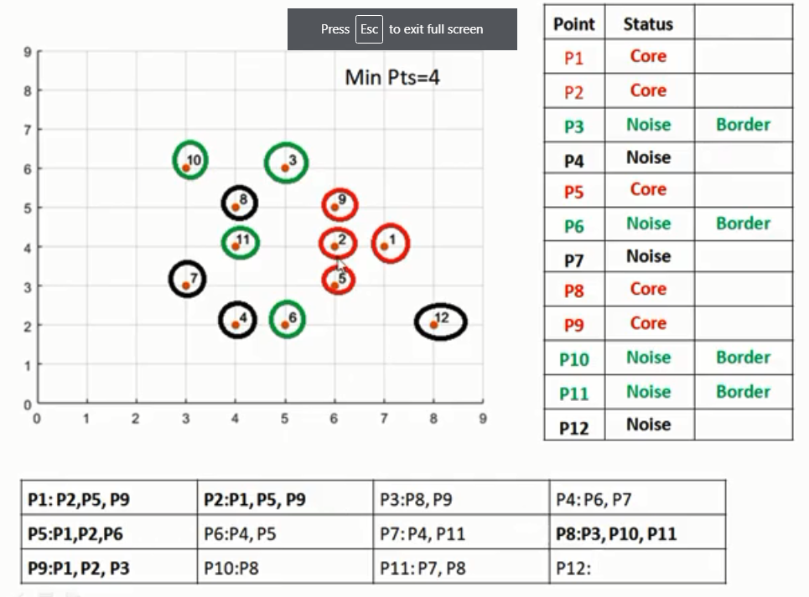
Cluster formed : cluster 1 with points (1,2,5 and 9 ) , cluster 2 with points (8,11,10 and 3) and other points are noise.

